Slide 1
Hybrid LSTM–XGBoost Model for Highway Vehicle Trajectory Prediction
Doweon Kim
CSCI 538 – Final Project
November 30, 2025

Slide 2
Contents
Introduction & Problem Definition
Dataset( NGSIM US-101)
Data Preprocessing
Model Architecture
LSTM Prediction
Residual Correction(XGBoost)
Hybrid Model
Results & Evaluation
Discussion & Insights
Conclusion & Feature Work

Slide 3
Introduction
Vehicle trajectory prediction is essential for
autonomous driving, lane-change assistance, and traffic modeling.
Predicting future positions is difficult because vehicles
accelerate, decelerate, and interact with surrounding traffic.
Thus, time-series models (e.g., LSTM) are commonly used to capture motion patterns.

Slide 4
Problem Definition
Goal: Predict the next Local_X and Local_Y positions of a vehicle on a highway.
Issue:
  LSTM performs well in X-direction (lateral movement).
  But Y-direction (longitudinal / forward movement) shows large drift and accumulated errors.
Challenge:
→ Reduce Y-axis drift and improve overall trajectory accuracy.

Slide 5
NGSIM US-101 Dataset Overview
Collected by the U.S. Department of Transportation.
Contains high-resolution highway vehicle trajectories (10 Hz).
Includes positions, velocity, acceleration, lanes, and surrounding vehicle IDs.
Widely used in research for realistic traffic behavior modeling.

Slide 6
Key Features Used
Local_X, Local_Y (vehicle position)
v_Vel (velocity)
v_Acc (acceleration)
Computed features: speed, acceleration, heading

Slide 7
Why US-101 Section?
Smaller and more manageable dataset
Has cleaner lane structure → easier trajectory modeling
Suitable for early model development and experimentation

Slide 8
Data Preprocessing
Cleaning Raw NGSIM Data
Feature Engineering
Data Filtering

Slide 9
Cleaning Raw NGSIM Data
Removed missing values, jump frames, and tracking errors
→ e.g., wrong Frame_ID sequence
Filtered out unrealistic speeds and abnormal accelerations
Downsampled data from 10 Hz → 1 Hz
→ reduces noise, smoother trajectory sequences

Slide 10
Feature Engineering
Converted units : Feet → Meters
Computed additional Features
  Speed(from position change)
  Acceleration
  Heading
Selected final features for Modeling :
  Local_X, Local_Y, speed, v_vel, v_Acc, acceleration

Slide 11
Data Filtering
Kept only vehicles with ≥ 30 frames
→ ensures enough sequence for LSTM training
Removed vehicles with inconsistent tracking patterns
Separated train/val/test by Vehicle_ID
→ prevents data leakage

Slide 12
Data Processing
Scaling
Sequence Generation

Slide 13
Scaling
Applied MinMaxScaler
Fitted only on training set
Applied to validation/test

Slide 14
Sequence Generation
Used a sliding-window method
Tested sequence lengths: 5, 8, 10
Final model uses seq_len = 10 (best validation performance)

Slide 15
LSTM Model
Model Architecture
Training Settings
Sequence Length Experiments
Key observation

Slide 16
Model Architecture
LSTM Layer(64)
Dense layer (32)
Output layer : 2 values
  Next _Step : Local_X
  Next_Step : Local_Y

Slide 17
Training Settings
Loss function: MSE
Optimizer: Adam
Early stopping applied to prevent overfitting

Slide 18
Sequence Length Experiments
Tested: 5, 8, 10
Best validation performance: seq_len = 10
Chosen for final model training

Slide 19
Key Observation
LSTM predicts Local_X well
But Local_Y shows large drift over time
→ motivates need for residual correction (XGBoost)

Slide 20
Residual Correction (XGBoost)
Why is correction needed?
What does XGBoost do?
Why correct only Y?
How is it used in the final model?

Slide 21
Why is correction needed?
The LSTM model predicts X positions accurately,
but shows significant drift in the Y direction over time.
A correction module is needed to reduce this accumulated Y-error.

Slide 22
What does XGBoost do?
XGBoost learns the error pattern that the LSTM makes.
It works like an “error corrector” by learning how much the LSTM prediction is off.
Instead of predicting positions, it predicts how wrong the LSTM was.

Slide 23
Why correct only Y?
X direction is already very accurate → correction wasn’t helpful.
Y direction improves noticeably when corrected.
Therefore, only the Y residual is adjusted by XGBoost.

Slide 24
How is it used in the final model?
X stays exactly as predicted by the LSTM.
Y is updated using XGBoost correction.
This significantly reduces drift and produces a more stable trajectory.

Slide 25
Hybrid Model (LSTM + XGBoost)
LSTM predicts the initial (X, Y).
XGBoost corrects only Y to reduce drift.
Final Output = X from LSTM, Y from corrected result.
Produces a more accurate and stable trajectory.

Slide 26
Results & Evaluation
LSTM shows strong performance in X but large drift in Y.
Hybrid model greatly reduces Y-direction error.
Overall 2D accuracy improves significantly.
Corrected trajectory follows the true path more closely.

Slide 27
Visual Comparison
Trajectory Comparison
Residual Scatter Plot
MSE Bar chart

Slide 28
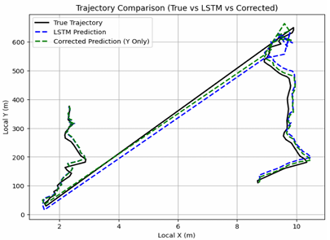
Trajectory Comparison
The corrected trajectory (Green) stays closer to the true path than the LSTM prediction (Blue).
LSTM drifts away in the Y direction, but the hybrid model reduces this drift significantly.
The overall movement becomes more aligned with real vehicle behavior.

Slide 29
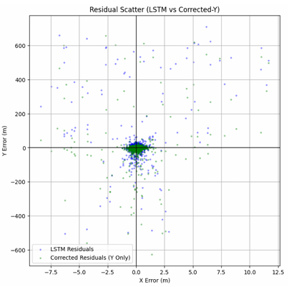
Residual Scatter Plot
LSTM residuals form a wider spread, especially along the Y axis.
After correction, residuals become more concentrated near the center.
Fewer large Y-errors → shows that the hybrid model reduces high-magnitude mistakes.

Slide 30
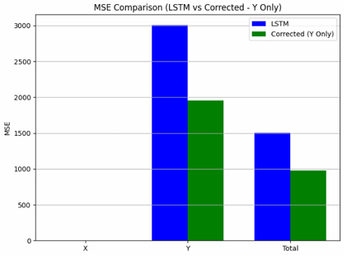
MSE Bar Chart
X MSE: unchanged (X is not corrected).
Y MSE: significantly lower after correction.
Total MSE: reduced noticeably → confirms overall improvement.
Improvement:
X: 0% (unchanged)
Y: 34.97%
Total: 34.97%

Slide 31
Discussion & Insights
LSTM predicts X well but drifts in Y.
XGBoost effectively corrects Y errors → hybrid model is stronger.
Longer sequence length improves prediction.
Vehicle data characteristics shaped the modeling choices.

Slide 32
Conclusion & Future Work
Conclusion
Hybrid model (LSTM + XGBoost) improves Y drift and overall accuracy.
LSTM handles trends; XGBoost fixes remaining errors.
Achieved more stable, realistic trajectory predictions.
Future Work
GRU, Transformer models
Multi-step forecasting
Use surrounding vehicle data
Explore longer sequences

Slide 33
Thank You

